Slide 1
TWEESENT
Sentiment Analysis of COVID-19 Tweets – Visualization Dashboard
DATA VISUALIZATION
By:
NameTerror
(Sharv Dumbre)

Slide 2
Data Visualization
Data visualization is the graphical representation of information and data. By using visual elements like charts, graphs, and maps, data visualization tools provide an accessible way to see and understand trends, outliers, and patterns in data.
In the world of Big Data, data visualization tools and technologies are essential to analyze massive amounts of information and make data-driven decisions.

Slide 3
Why data visualization is important?
It’s hard to think of a professional industry that doesn’t benefit from making data more understandable. Every STEM field benefits from understanding data—and so do fields in government, finance, marketing, history, consumer goods, service industries, education, sports, and so on.
While we’ll always wax poetically about data visualization there are practical, real-life applications that are undeniable. And, since visualization is so prolific, it’s also one of the most useful professional skills to develop. The better you can convey your points visually, whether in a dashboard or a slide deck, the better you can leverage that information.

Slide 4
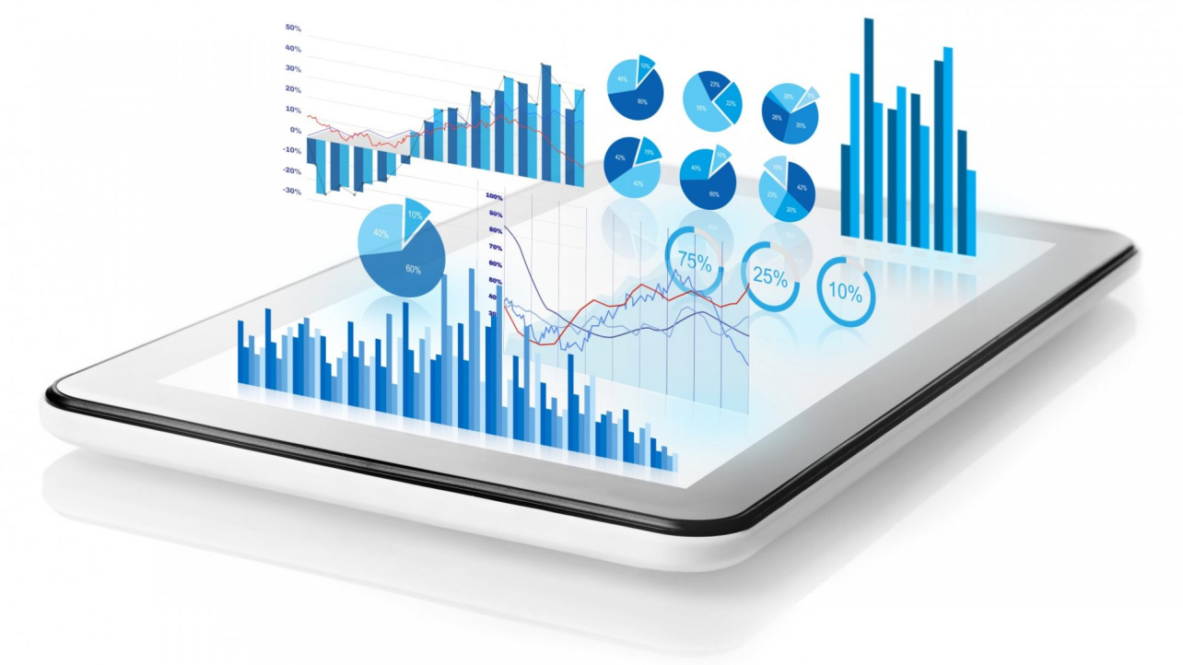
Common general types of data visualization:
Charts
Tables
Graphs
Maps
Infographics
Dashboards

